Slide 1
2023 NAFB LISTENERSHIP

Slide 2
OBJECTIVES
1
Examine the habits and practices of those who consume ag radio programming
Inform future strategies for sales and programming
2
STUDY SUMMARY
357 phone interviews during Summer 2023
Nationwide sample of decision-makers on operations of $100K+ GFI
Regularly consume ag radio content

Slide 3
CONTENT & CONSUMPTION

Slide 4
Ag radio is the leading daily source of farm news
Daily Sources of Ag News
Ag/farm radio
Ag/farm television
Ag/farm publications
Blogs/websites/news sources that I seek out
Online farm forums
E-newsletters I receive from suppliers
Social media
Ag/farm related apps for smartphone/tablets
Text notifications from suppliers, manufacturers
E-newsletters I receive from publications
Company or industry websites
Ag/farm shows
Farm radio websites
Ag/farm podcasts
Listeners tune into ag radio for timely information every day. The type of content ag radio provides (weather, markets and news) lends itself to daily consumption.
Source: Total 2023 respondents (n=357)
CONFIDENTIAL
Notes:
Q11: What are your daily news sources for farm news, weather, markets, and ag information?

Slide 5
Ag broadcast radio is the number one source for farm news among listeners.
Sources of Farm News
Broadcast radio
Ag/farm publications
Ag related websites
Television
Social media
YouTube
Online forums
Podcasts
Satellite radio
Online radio
Streaming services
Those who regularly listen to ag radio content are also engaged in other media channels to keep up to date with farm news, weather, markets, and ag info.
On average, respondents utilize several informational sources.
Source: Total 2023 respondents (n=357)
NOTE: Some shares adjusted to align with subsequent responses later in the survey.
Notes:
Q7: In what ways do you keep up to date with farm news, weather, markets, and ag information? (READ LIST)

Slide 6
QUAL INSIGHTS
“
Media & Information Sources
Listeners rely on a wide range of sources - news, radio, podcasts, social media, and connecting with peers.
They are always trying to gather information to make them better at all the various aspects of their job.
… I don't go anywhere without turning my radio on in my truck…And I still listen a lot to that local radio station to get the weather, the news, and their spin on it.
– Farmer Listener from Illinois
Information Sources
There is a wide range of ag information that they rely on, including radio broadcasts, farm magazines, podcasts, YouTube videos, newsletters, and specific online platforms.
They leverage these sources to stay informed and gain knowledge about farming practices.
CONFIDENTIAL

Slide 7
Listeners look to ag radio for info that directly impacts their operations.
While listeners rely on ag radio for info on a variety of topics, market info and commodity pricing, as well as weather are the two most pertinent topics for ag radio listeners.
These are the two most relevant areas of ag radio content regardless of age, GFI, or operation size.
Info Desired from Ag Radio
Ag markets/Commodity prices
Ag weather
Local/Regional Ag news
Farm commentary
World Ag/Trade News
Insights from Washington DC/Policy updates
New Products; seed, equipment, technology
Agriculture innovation
Source: Total 2023 respondents (n=357)
Notes:
Q34: Thinking of your local farm broadcast that you access via broadcast or streaming, what types of information do you get when you listen to your local farm broadcaster?

Slide 8
Across all ages, farm broadcasters have high levels of trust with ag radio listeners . . .
High 8-10
Low 1-7
High trust* in ag broadcasters
Source: Total (n=357) *Gave rating of 8, 9, or 10 on scale from 1-10.
Notes:
Q35: Thinking of the farm broadcaster who delivers farm news, weather, markets, and ag information, please rate them on a scale of 1 to 10, where 10 is excellent and 1 is very poor, on the following factors

Slide 9
…and they trust farm broadcasters to provide critical info accurately and on time.
Listeners were asked how they feel about their farm broadcaster, as well as national news media in the areas of credibility, accuracy, and timeliness.
Farm broadcasters dramatically outperform national news media (NBC, CBS, etc.) on all three of these measures.
Perceptions of Media*
National news
Farm broadcaster
Credible
Accurate Information
Timely Information
Source: Total 2023 respondents (n=357)
Note: *8, 9, or 10 on a 1-10 scale where ‘1’ is ‘very poor’ and ’10’ is ‘excellent’
Notes:
Q35: Thinking of the farm broadcaster who delivers farm news, weather, markets, and ag information, please rate them on a scale of 1 to 10, where 10 is excellent and 1 is very poor, on the following factors
Q41: Thinking of national news media outlets, such as NBC, CBS, ABC, New York Times, etc., please rate them on a scale of 1 to 10, where 10 is excellent and 1 is very poor, on the following factors

Slide 10
QUAL INSIGHTS
“
(Farm) Broadcasters are trusted friends. I truly believe that they want to tell you the true story. The right story. Without any bias.
– Farmer from South Dakota
Trust
They deem it important to have trust in the information they receive and indicate they have confidence in farm broadcasters as trusted sources of information who provide accurate and unbiased news.
There is an appreciation for farm broadcasters' role in sharing market updates and global events.
CONFIDENTIAL

Slide 11
ADVERTISING EFFECTIVENESS

Slide 12
Ag radio broadcasts drive listeners to advertiser websites
58%
Visited website after hearing about it on ag radio
Within the past 6 months, over half of listeners have visited a website that they heard about on the radio.
This percentage rises to over 70% for radio listeners who are under 55 and/or engaged in digital media such as podcasts, YouTube, or streaming radio.
Source: Total 2023 respondents (n=357)
Notes:
Q37: In the past 6 months, have you visited a website as the result of hearing about a product on an ag-related broadcast?

Slide 13
Farm-radio listeners are more likely to have visited a website after hearing about it on the radio.
18-54
55+
29%
47%
71%
53%
Visited website after hearing about it on radio
Source: 18-54 (n=90); 55+ (n=267)
Notes:
Q37: In the past 6 months, have you visited a website as the result of hearing about a product on an ag-related broadcast?

Slide 14
LISTENING HABITS

Slide 15
Traditional AM/FM radios have extensive reach throughout farming operations
The average listeners’ farm contains nearly 11 radios with more than half having 20+
Because AM/FM radios are a standard feature of on-farm infrastructure, ag programming can easily and conveniently reach listeners at various times and locations.
AM/FM radio broadcasts are prevalent throughout farms. Farmers listen to broadcast ag radio in a variety of locations and situations. This is made possible by the large number of radios that can be found throughout farming operations.
Types of Radio Use for Farm News
Where Listen to Ag Radio
Source: Total 2023 respondents (n=357); Listen to AM/FM radio (N=317)
CONFIDENTIAL
Notes:
Q36: Where do you listen to farm news, weather, markets, and ag information on the radio
Q19: How many AM/FM radios in total do you have on your property?
Q24: Do you ever listen to ‘streaming radio’ live or on-demand?
Q13:On which of the following radio bands do you listen to farm news, weather, markets, and ag information?

Slide 16
A higher number of radios on-property is linked to varied listening venues.
Where listen to ag content
Source: 1 to 5 radios (n=79); 6 to 10 radios (n=129); 11+ radios (n=109)
Notes:
Q36: Where do you listen to farm news, weather, markets, and ag information on the radio at this time of year?

Slide 17
On-air ag radio is a major part of listeners’ weekday routine.
Those who listen to AM/FM radio for ag programming do so on most days with a large majority (83%) listening at least 5 days per week.
5+ Days a Week
83%
Source: Listen to AM/FM radio (n=317)
Notes:
Q20: Thinking of your radio listenership, typically how many days per week do you listen for farm news, weather, markets, and ag information on traditional AM or FM broadcast radio?
Q22: On a typical weekday, how many minutes do you spend listening to farm news, weather, markets, and ag information on broadcast radio?

Slide 18
Listeners start each morning by tuning into ag radio for the day’s most important information.
Time of Day Listen to Ag Radio Programming
Listening to on-air ag radio is a key ingredient to farmers morning routine.
This pattern holds for both AM/FM and streaming radio.
Source: Listen to AM/FM radio (n=317); Listen to streaming radio (n=95)
Notes:
Q21: When during the day do you listen to broadcast radio for farm news, weather, markets, and ag information?
Q26: When during the day do you listen to ag-related streaming radio?

Slide 19
DIGITAL MEDIA CHANNELS

Slide 20
Listeners use digital media channels to gather ag-based information.
Portion of Content Consumed that is Ag-related
All Ag-related
Most Ag-related
Half or less Ag-related
YouTube
Podcasts
Source: Ever listened to ag podcast (n=186); Regularly watch ag-related YouTube programming (n=112)
Notes:
Speaks to info-seeking tendencies—casting a wide net. Podcasts especially ag-centric.
Q44:Thinking about the YouTube programming that you watch, what portion of that content is ag-related?
Q32:Thinking about the podcasts that you regularly listen to, what portion of those podcasts are ag-related?

Slide 21
Younger listeners are more engaged in digital media channels than their seasoned counterparts.
Source: 18-44 (n=52); 45+ (n=305)
Notes:
Q7: In what ways do you keep up to date with farm news, weather, markets, and ag information?
Q24: Do you ever listen to ‘streaming radio’ live or on-demand?
Q31: When was the last time you listened to a podcast on an agricultural topic?
Q43: Do you regularly watch ag-related YouTube programing?

Slide 22
KEY FINDINGS & RECOMMENDATIONS

Slide 23
KEY TAKEAWAYS
1
Ag radio is a trusted resource for commodity prices and weather.
Among listeners, tuning into ag radio in the morning is a key part of their daily routine.
Broadcast ag radio’s widespread physical presence on farming operations gives it a competitive advantage in terms of reach.
Digital online media consumption of ag-content through YouTube, podcasts, and streaming radio is more prevalent among younger farmers.
Ag radio drives engagement with websites mentioned on the air. This is especially the case for listeners who are more digitally engaged and younger.
2
3
4
5

Slide 24
RECOMMENDATIONS
1
Continue to focus on key content of News, markets, and weather
Focus ad sales message on broadcast radio’s unique physical reach and the routine nature of its listenership.
Be mindful that younger listeners are more digitally engaged than their older counterparts.
2
3

Slide 25
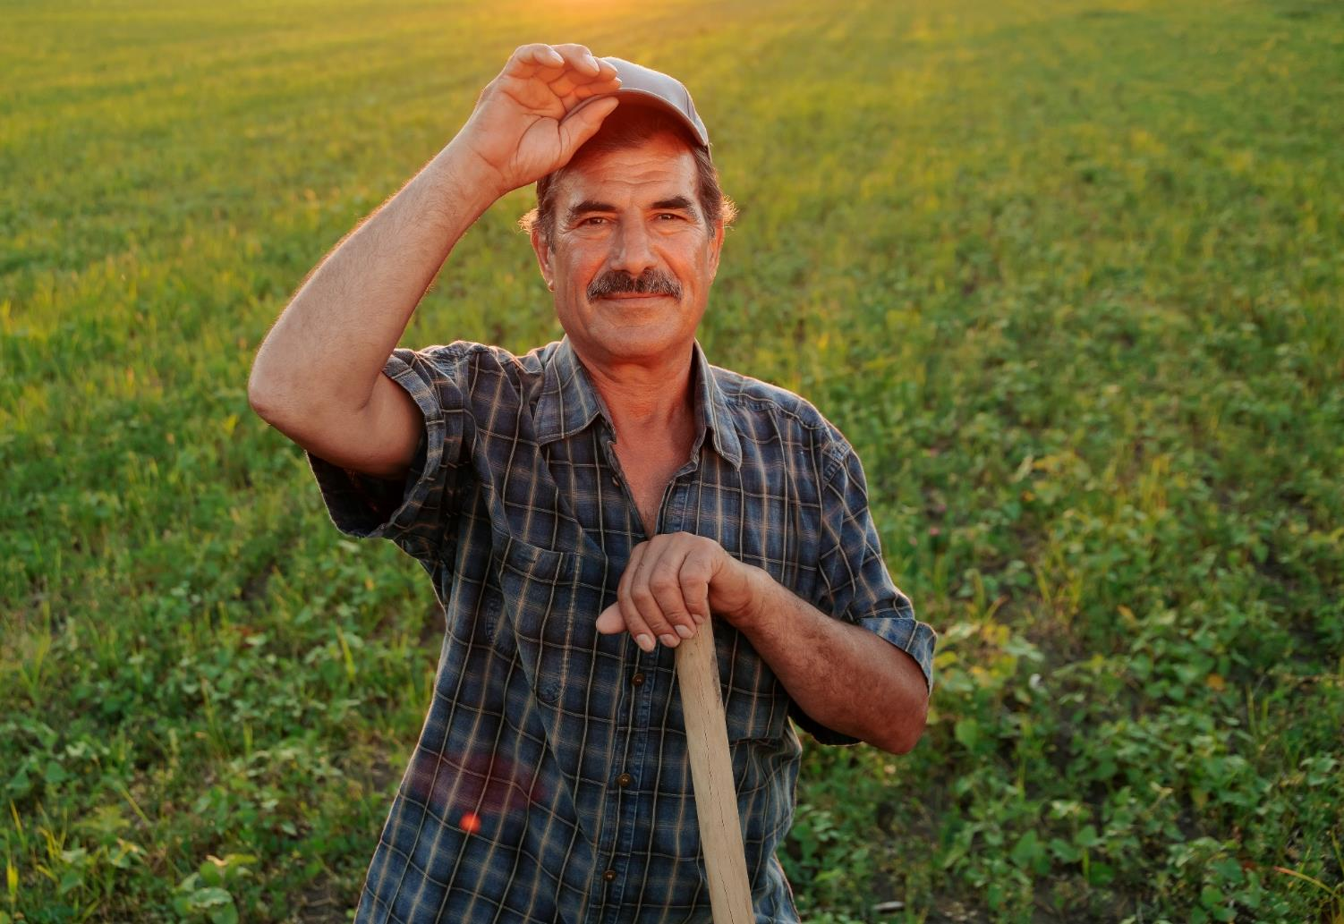
“
Sometimes guys like me are working alone in the shop or you're in the tractor wondering if you're the only one having the problems or facing the challenges you're facing. Then you tune in to ag media (radio) and you hear other people like you talking about having the same problems and it gives me comfort knowing I'm not alone. And they have advice and information that helps me. Maybe I'm thinking about biologicals and whether I should try them, I can go look up recent podcasts or broadcasts or articles and that gives me a start.
Farmer from Ohio
CONFIDENTIAL

Slide 26
CURRENT ENVIRONMENT

Slide 27
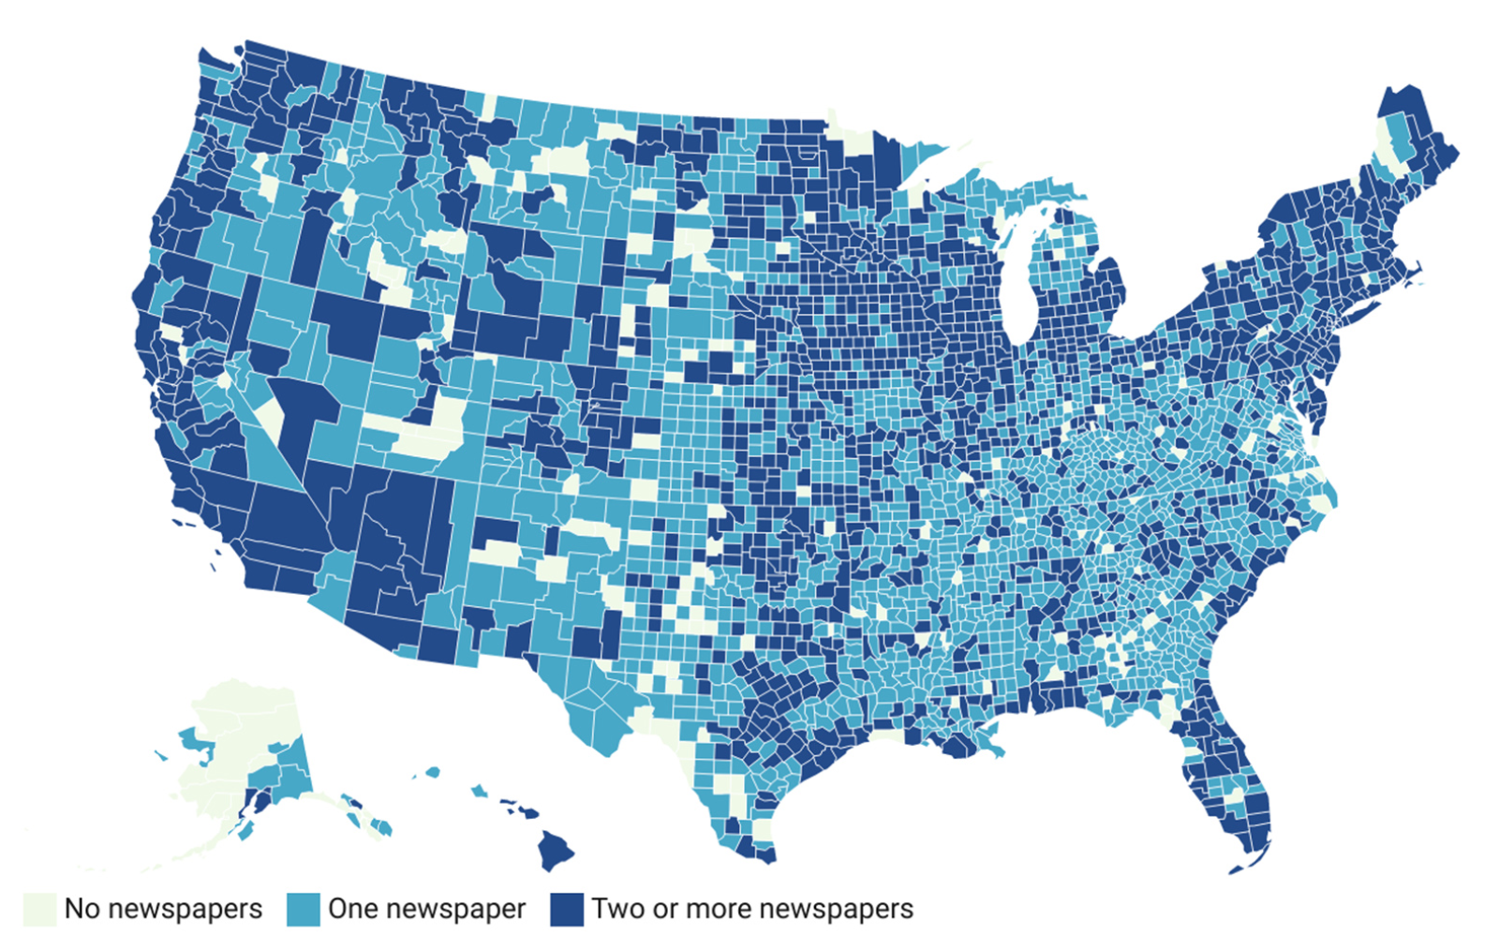
Newspaper Decline
Currently losing newspapers at a rate of 2 per week
The U.S. has lost more than a quarter of its newspapers and is on track to lose a third by 2025.
Rural areas are the most affected.
Source: Northwestern University – Medill School of Journalism, Media, and Integrated Marketing Communications

Slide 28
ADDITIONAL DATA

Slide 29
Unlike broadcast radio, satellite radio listenership is limited to passenger vehicles.
Where Listen to Satellite Radio Most Often
Satellite receiver in truck or car
Listen through telephone app to ear buds, headphones, or Bluetooth speaker
Satellite receiver in ag equipment
Stationary speaker in home or shop that accesses satellite service via wifi
Via computer & computer speakers
Presence of Radio Devices in Ag Equipment (combines, etc.)
81%
22%
AM/FM Radios
Satellite Radio
Source: Total 2023 respondents (n=357); Pay for satellite radio (n=108); Listen to AM/FM radio (n=317)
Notes:
Q15: What vehicle(s) have an active, satellite radio account that you pay for?
Q17: What vehicle(s) has a working AM/FM radio?
Q13: On which of the following radio bands do you listen to farm news, weather, markets, and ag information?
Q16:What device do you use most often to listen to programming from your paid satellite radio account?

Slide 30
…and the content consumed on satellite radio is not predominantly ag focused.
While 30% of listeners interviewed pay for a satellite radio subscription, only 22% use the service to gather ag-related news.
This, along with satellite’s limited on-farm presence, suggests that satellite radio is not a major conveyer of ag news.
Satellite Radio Purchase and Listenership
30%
22%
Pay for Satellite Radio Subscription
Listen to Satellite Radio for Ag News
Source: Total 2023 respondents (n=357); Pay for satellite radio (n=108); Listen to AM/FM radio (n=317)
Notes:
Q14: Do you pay for a subscription to satellite radio?
Q13: On which of the following radio bands do you listen to farm news, weather, markets, and ag information?

Slide 31
Reasons People Don’t Click Banner Ads
Percentage of Respondents Who Agreed With the Statement
Source: Snap Digital Agency

Slide 32
Those who visited a website after hearing about it on the radio are more likely to access digital, non-digital news sources.
Daily ag news sources
Source: Visited website (n=206); Did not visit website (n=151)
Notes:
Q11: What are your daily news sources for farm news, weather, markets, and ag information?

Slide 33
AUDIENCE SAMPLE

Slide 34
Listener Demo Profile
3%
71%
Northeast
Gender
Midwest
14%
Female
10%
86%
Male
West
16%
South
Source: Total 2023 respondents (n=357)

